Slide 1
HR ATTRITION ANALYSIS
PREPARED AND SUBMITTED
BY
Emezie Oluchi

Slide 2
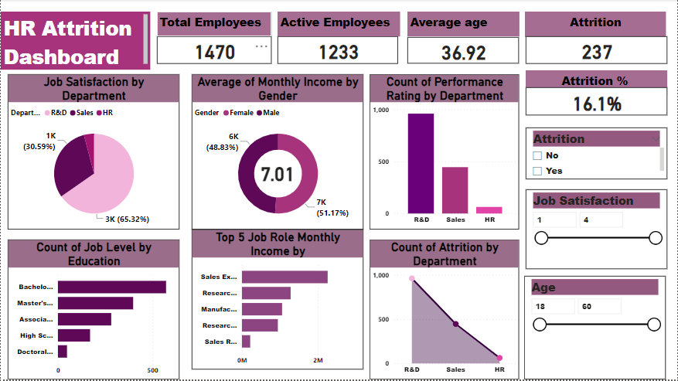
HR ATTRITION DASHBOARD

Slide 3
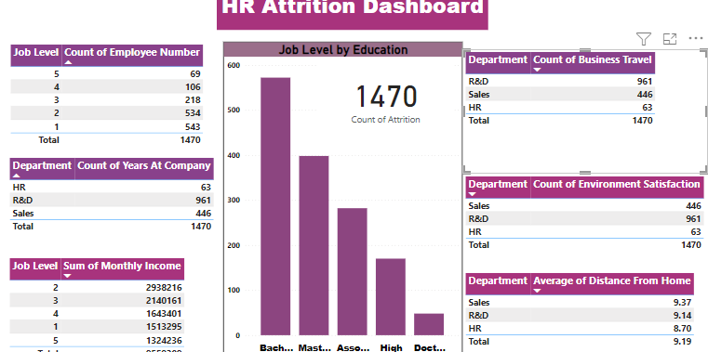
HR ATTRITION DASHBOARD

Slide 4
About In this project, we delve into the multifaceted factors contributing to employee turnover, explore its impact on the organization, and propose strategies to mitigate its adverse effects. Business Problem The company faces a pressing challenge with a 16.12% attrition rate among its workforce. This high turnover not only incurs substantial recruitment costs but also disrupts team dynamics and dampens employee morale. To address this challenge, the company must delve into the underlying reasons for attrition and develop targeted strategies to retain talent and maintain organizational stability. Applied Steps Data Cleaning and Transformation: This involved checking for duplicates and other errors and using the right data types. Data Load: Data was loaded into SQL ‘HR database’ to answer pertinent business questions. Data Visualization: Data was loaded into Power BI to create interactive dashboards and generate insights.

Slide 5
Insights 1. The company has 1470 total employees, an attrition count and attrition rate of 237 and 16.12% respectively, leaving 1233 active employees. With an attrition rate of 16.12%, it indicates that the company is losing employees at a relatively high rate. 2. Younger employees tend to have higher attrition rates, possibly due to career exploration or changes. Attrition rates decrease as employees progress through their careers, with a slight increase seen among older employees, which might be influenced by retirement or other factors. 3. Major factors which might influence job satisfaction and attrition include work-life balance, relationship satisfaction and whether the employee works overtime. 4. Employees at job level 1, 3, and 2 have the highest attrition percentage. In addition, they have the lowest job satisfaction rating. 5. Males have a higher attrition count (150 to 87) while females have a higher attrition rate. 6. The Research & Dev dept, with 961 employees, has the highest performance rating, while the HR dept, with 63 employees, has the lowest. This suggests a correlation between workforce size and performance.

Slide 6
7. The Research & Dev dept were trained the most times while the HR dept were trained the least. This provides a potential explanation for their respective highest and lowest performance ratings. 8. With an average of 7 years of service with the company, employees demonstrate a notable commitment to the organization.

Slide 7
Recommendations Career Development: The company should focus on providing career development opportunities and mentorship programs for younger employees to increase their engagement and commitment to the organization. Training and Teamwork: To improve performance in the HR and Sales dept, the company should consider providing more training opportunities for staff to enhance their skills. Lastly, resource allocation should be optimized in the Research department to ensure continued success. Improve Job Satisfaction: To maintain employee retention, the company should focus on aspects vital to employee satisfaction such as work-life balance, relationship satisfaction, and less overtime. Investment in Leadership Development: Given the lower attrition rates among mid-career and senior employees, organizations can invest in leadership development programs to groom future leaders and provide growth opportunities for employees at all stages of their careers. Feedback and Communication: Establishing open channels of communication and providing regular feedback can help address any issues or concerns that may contribute to attrition.

Slide 8
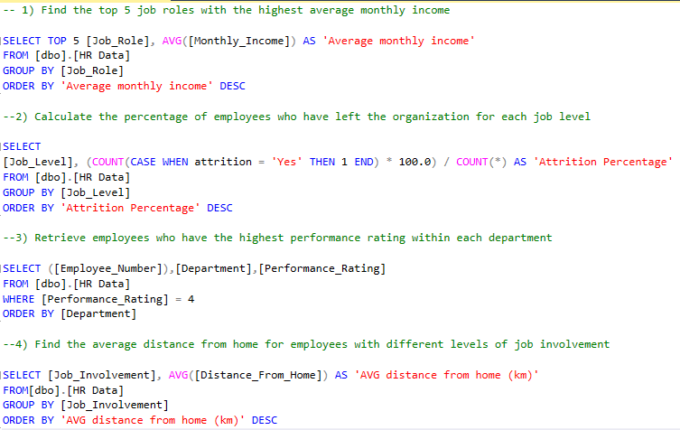
SQL SCRIPT

Slide 9
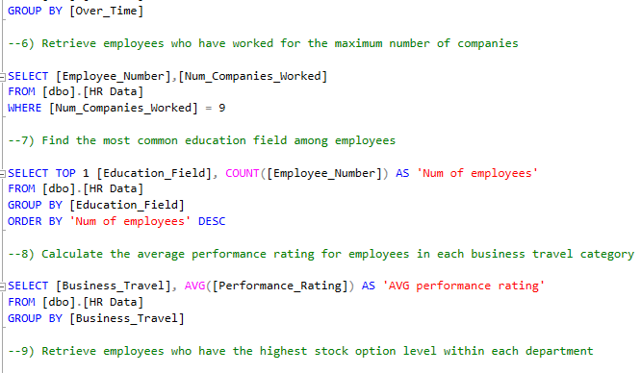
SQL SCRIPT

Slide 10
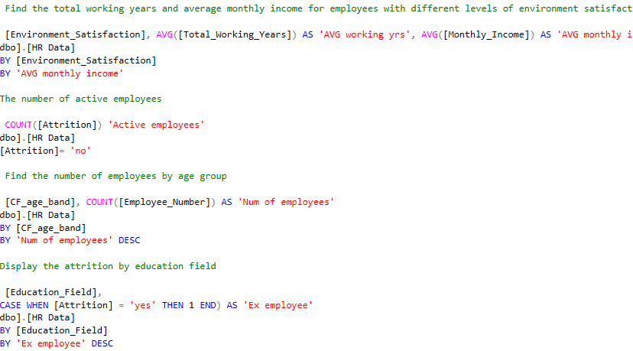
SQL SCRIPT

Slide 11


